Slide 1
D1B Splash Page
FIS Resource Kit

Slide 2
Table of Contents
3 Solution Overview:
Autobooks D1B Splash Page
4-8 Creating your Autobooks Splash Page
9 Autobooks HTML Code
10 Publishing your Autobooks Splash Page
11 Maximizing your Autobooks Splash Page
PAGE
See page 300-301, Digital One Business BST User Guide for additional details.
Feel free to contact our team at anytime and we’re happy to further assist FISembedded@autobooks.co

Slide 3
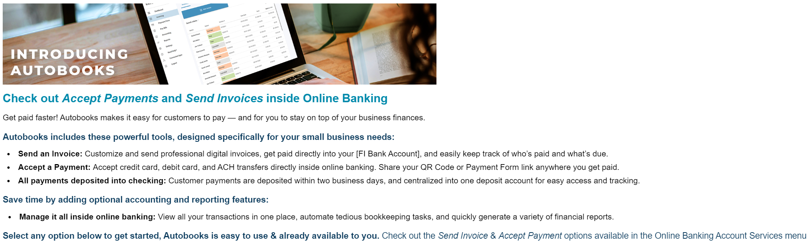


D1B
Splash Page
$2.2B INSTITUTION LAUNCHED MARCH 2022
After launching the Autobooks splash page, adoption INCREASED 207%
Functionality is included within D1B, configured via BST tools
Splash Page Tool allows for custom content creation via standard HTML, including option to embed links/files
An institution can designate different content for primary admins vs. standard users
Able to track user engagement; opt-in vs. ‘remind me later’ and build follow-up targeting
Let’s Get Started
Remind Me Later
Proceed to Online Banking
Customer Experience:
Proceed to Online Banking → Enroll in Autobooks
Follow-Up Autobooks Leads & Opportunities
Notes:
Get started

Slide 4
Creating Your Splash Page
Click Messaging > Create > Create Marketing Item
Type or select an Expiration Date
Select a splash page type: Marketing Splash Page
  NOTE: the Informational Splash Page and Marketing Splash Page options essentially provide a way for you to categorize your splash pages. Otherwise, they both have the same features/functions.
BEST PRACTICES:
Provide a short burst of information to the company user to grab their attention
Include a click-thru so the company can go directly to your Autobooks landing page
Configure to always display the message until Expiration Date, unless deferred by user

Slide 5
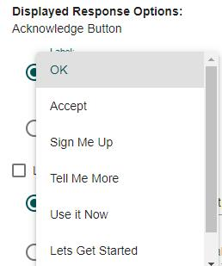
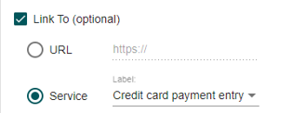
Creating Your Splash Page: Acknowledge Option
Choose the displayed response options:
  The Acknowledge button is required for all splash pages and allows the company user to accept and use the service or information included in the splash page.
To set up the Acknowledge button,
do one of the following:
Select the Label radio button and click the related drop-down and select a pre-defined label.
    “Let’s Get Started” is recommended.
Link to the Autobooks Menu in Online Banking.
    NOTE: See slide 11 for details on how to maximize these follow-up opportunities.
NOTE: Button font & colors are defined by FIS and cannot be changed.

Slide 6
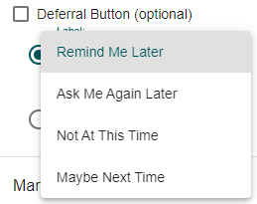
Creating Your Splash Page: Deferral Option
Choose the displayed response options:
  The Deferral button is optional and allows users to postpone their review of the splash page until their next sign-on.
To set up the Deferral button:
Click the Deferral Button check box
Do one of the following:
  Select the Label radio button and click the related drop-down and select a pre-defined label.
  “Remind Me Later” is recommended
    NOTE: See slide 11 for details on how to maximize these follow-up opportunities.
NOTE: Button font & colors are defined by FIS and cannot be changed.

Slide 7
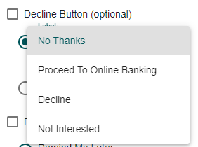
Creating Your Splash Page: Decline Option
Choose the displayed response options:
  The Decline button is optional and allows users to exit the splash page.
To set up the Decline button:
Click the Decline Button check box
Do one of the following:
  Select the Label radio button and click the related drop-down and select a pre-defined label.
  “Proceed to Online Banking” is recommended
NOTE: Button font & colors are defined by FIS and cannot be changed.

Slide 8
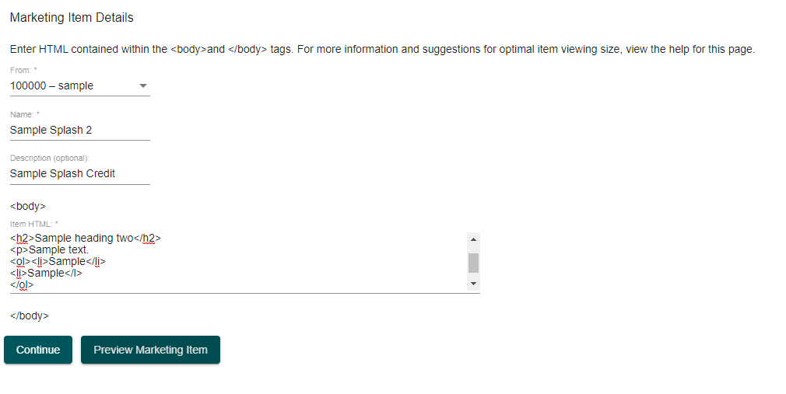
Creating Your Splash Page: Marketing Option Details
Complete the Marketing Option Details:
  From: Distribution list from which the splash page originated. Only distribution lists of which you are a member are available for selection.
  Name: Splash page name.
  Description: Optional. Splash page description, up to 160 alpha/numeric.
  Item HTML: Field supports hyperlinks and unlimited characters. See the next slide for Autobooks HTML code.
Click Continue
Review the Splash page information and click Save Changes

Slide 9
Autobooks
Splash Page HTML
<img src="https://content.autobooks.co/hubfs/External%20Images/FIS-D1B-Splash-Page-Image.png" alt="Introducing Autobooks" width="750">
<p style="font-family: Arial; color:#018AAC; font-size:20px; line-height: 1; margin-top: 10px; margin-bottom: 10px; padding-top: 0px"><strong>Check out <em>Accept Payments</em> and <em>Send Invoices</em> inside Online Banking</strong> </p>
<p style="font-family: Arial; font-size: 14px; line-height: 1.3; margin-bottom: 0px; padding-top: 0px;">Get paid faster! Autobooks makes it easy for customers to pay — and for you to stay on top of your business finances.</p>
<p style="font-family: Arial; font-size: 15px; line-height: 1.3; color:#0B3B5D; margin-bottom: 10px;"><strong>Autobooks includes these powerful tools, designed specifically for your small business needs: </strong></p>
<li style="font-family: Arial; font-size: 14px; line-height: 1.3; text-indent: -22px; margin-left: 30px; margin-right: 20%; margin-bottom: 5px;"><strong>Send an Invoice:</strong> Customize and send professional digital invoices, get paid directly into your [FI Bank Account], and easily keep track of who’s paid and what’s due. </li>
<li style="font-family: Arial; font-size: 14px; line-height: 1.3; text-indent: -22px; margin-left: 30px; margin-right: 20%; padding-bottom: 5px"><strong>Accept a Payment: </strong>Accept credit card, debit card, and ACH transfers directly inside online banking. Share your QR Code or Payment Form link anywhere you get paid. </li>
<li style="font-family: Arial; font-size: 14px; line-height: 1.3; text-indent: -22px; margin-left: 30px; margin-right: 20%;"><strong>All payments deposited into checking:</strong> Customer payments are deposited within two business days, and centralized into one deposit account for easy access and tracking. </li>
<p style="font-family: Arial; font-size: 15px; line-height: 1.3; color:#0B3B5D; margin-bottom: 10px;"><strong>Save time by adding optional accounting and reporting features: </strong></p>
<li style="font-family: Arial; font-size: 14px; line-height: 1.3; text-indent: -20px; margin-left: 30px; margin-right: 15%;"><strong>Manage it all inside online banking: </strong>View all your transactions in one place, automate tedious bookkeeping tasks, and quickly generate a variety of financial reports.</li>
<p style="font-family: Arial; font-size: 15px; line-height: 1.3; color:#0B3B5D; margin-top: 15 px; margin-bottom: 0px;"><strong>Select any option below to get started, Autobooks is easy to use &amp; already available to you.&nbsp;</strong>Check out the <em>Send Invoice</em> &amp; <em>Accept Payment </em>options available in the Online Banking Account Services menu</p>
Download HTML file
Autobooks HTML Code: Copy/Paste into the HTML section of BST Splash Page tool.
See page 300-301, Digital One Business BST User Guide for additional details.
Feel free to contact our team at any time and we’re happy to further assist you. FISembedded@autobooks.co

Slide 10
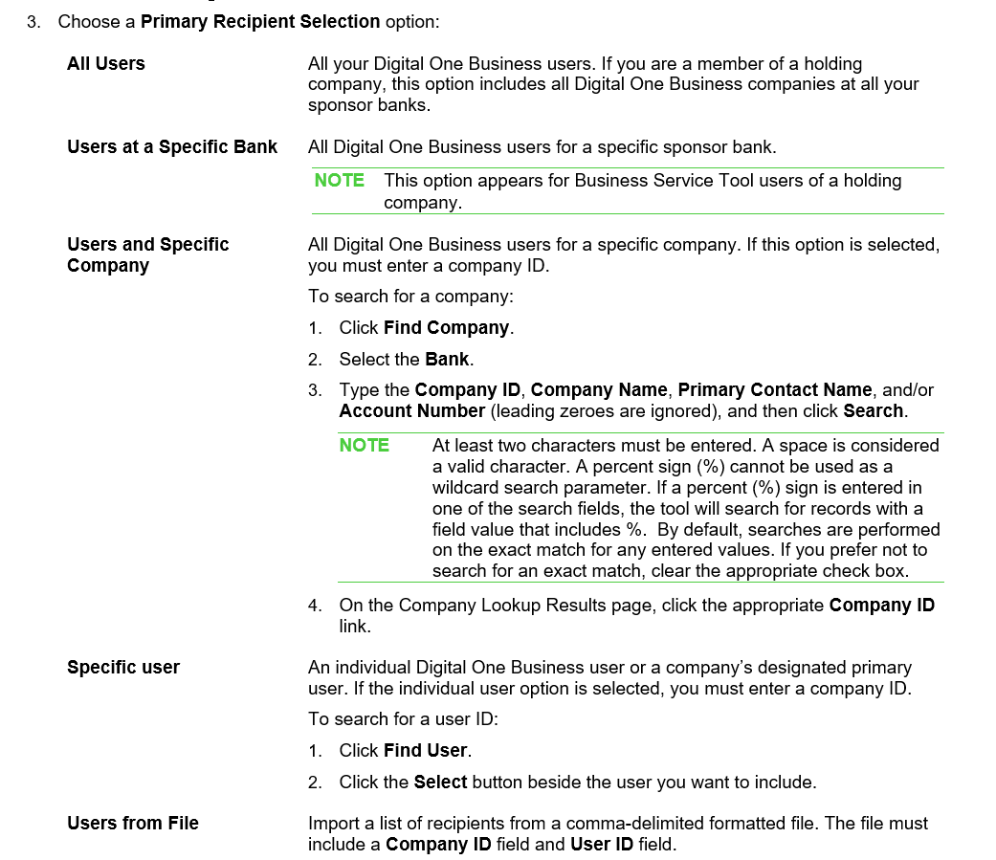
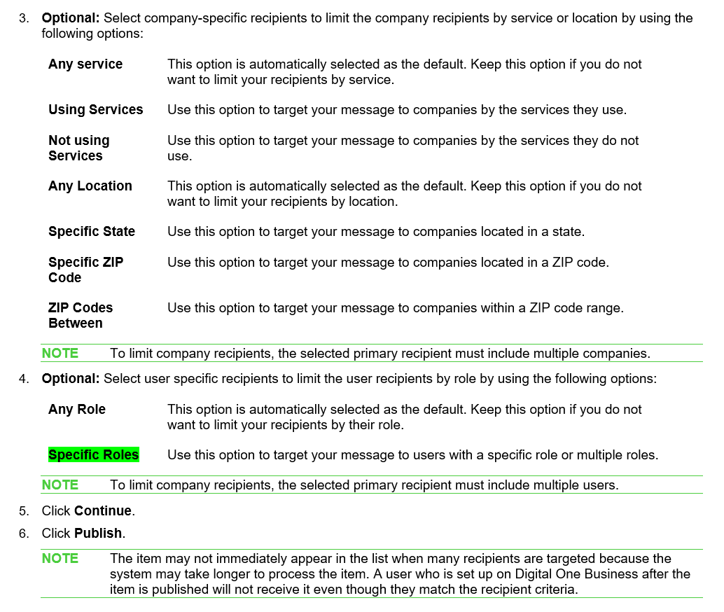
Publishing Your Autobooks Splash Page
Click Messaging > Send Mail
Click Marketing Item and then click the adjacent
drop-down to select Autobooks Splash Page
You can preview the splash page by clicking Preview Marketing Item

Slide 11
Maximizing Your
Autobooks Splash Page
How can your institution make the most out of customer responses to your Autobooks splash page?
TAKE ACTION!
Autobooks provides frontline tools & training to further support these critical follow-up conversations.
TRAINING TOOLS
Check out these Training Tools as your teams prepare to revisit these opportunities:
Videos
Enrollment Guides
Conversation Starters
Webinars

Slide 12
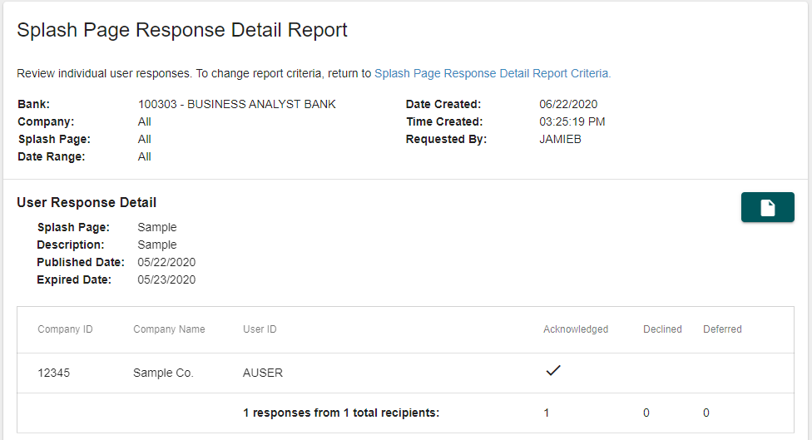
3 Steps to make the most of your Splash Page campaign
STEP 1
Navigate to the Splash Page Response Detail Report
Reporting > Batch Reporting > Report Selection > Splash Page Response Detail Report
STEP 2
Generate the Splash Page Response Detail Report
Sample Report detail:
STEP 3
Assign an internal action to each customer response
    Recommended actions for each response include:
        Declined: No further action
        Deferred: Follow up with customer to answer questions
        Acknowledged: Follow up with customer to answer questions

